Slide 1
STEADY STATE MODELING AND ANALYSIS OF A REVERSIBLE SOLID OXIDE FUEL CELL BASED ENERGY STORAGE SYSTEM
Kevin Scott
MS Thesis Defense
WSU School of Mechanical and Materials Engineering
July 2018
Notes:
Good morning,
Today, I will be defending my master’s thesis entitled “STEADY STATE MODELING AND ANALYSIS OF A REVERSIBLE SOLID OXIDE FUEL CELL BASED ENERGY STORAGE SYSTEM” where I characterized the performance of a reSOFC-based energy storage system in increasing the amount of renewable energy that is used.

Slide 2
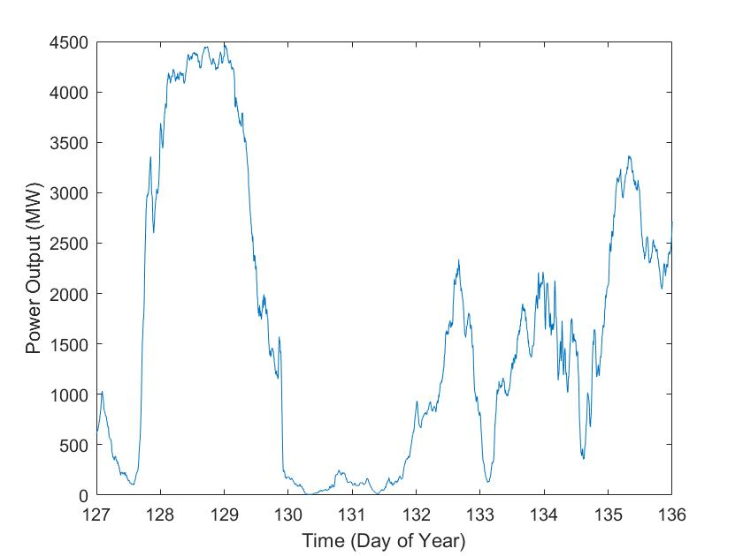
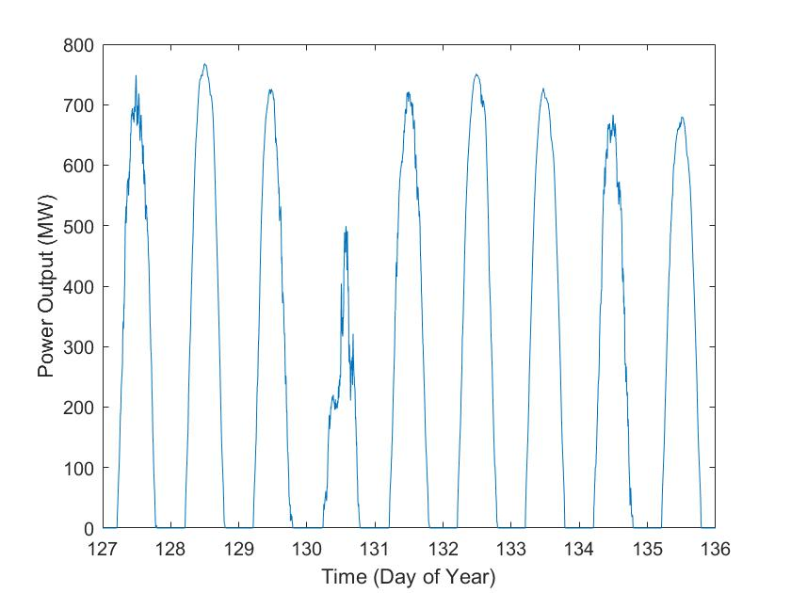
Motivation: Variable Renewable Energy
Non-dispatchable Power Output
Notes:
Variable renewable energy, which includes wind and solar power, is commonly seen as a way to reduce emissions caused by conventional fossil-fuel based generators.
However, the power generated by these systems is non-dispatchable, meaning that you can’t control when power is available. A sample wind power generation profile is shown on the left, and a sample solar power generation profile is shown on the right.
Due to the non-dispatchable nature of variable renewable energy, the use of large amounts of renewable energy significantly impacts the stability of the electrical grid.

Slide 3
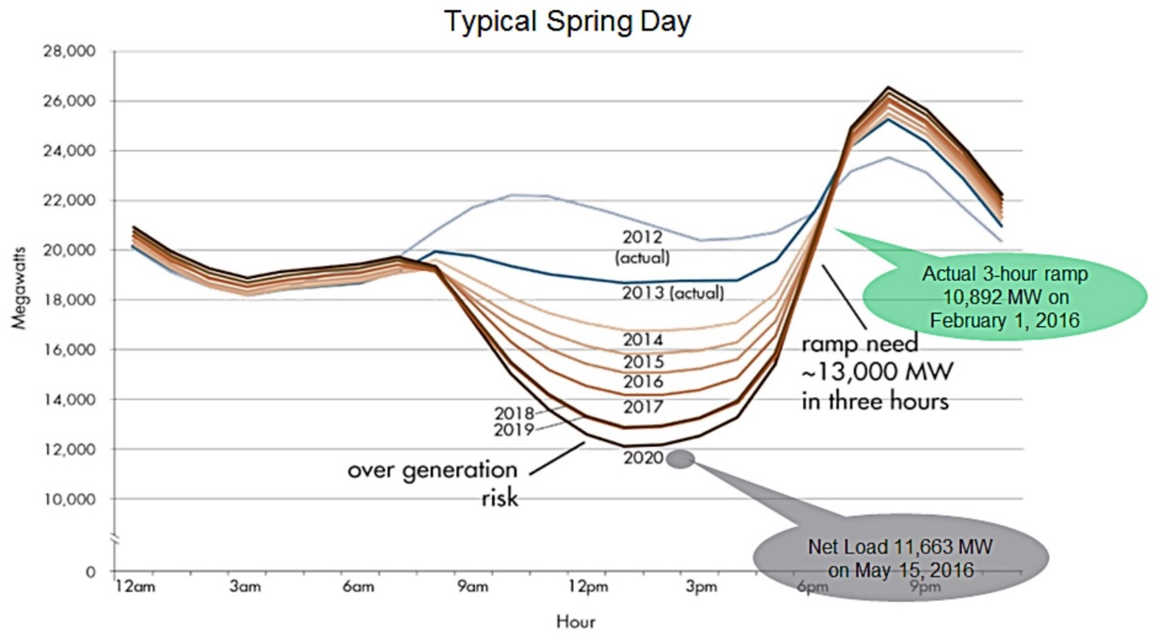
Effect of Variable Renewable Energy on Electrical Grid
Notes:
When variable renewable energy is used, conventional generators are used less. Due to the mismatch between the availability of variable renewable energy and the total power demand, the use of large amounts of variable renewable energy can result in large ramp rates and increased cycling of conventional generators.
This can be seen in the projected rate of power generation by conventional generators in California, also known as the “duck curve”. As the installed capacity of solar power increases over time, conventional generators are subjected to increased ramp rates at the end of the day, reducing grid stability.
The use of energy storage is one possible strategy for increasing grid stability. In this way, a reSOFC-based energy storage system can increase the amount of renewable power that is used.

Slide 4
Outline
Literature Review
Background
System Model
Energy Storage Application
Conclusions
Notes:
First I will go over useful background information in understanding the work that I’ve done,
Then I will describe the steady state model of a reSOFC-based energy storage system that I created.
Then I will describe application of that model to the problem of increasing the use of renewable energy in the pacific northwest.
Finally, I will review my conclusions and what next possible steps would be in further research on this topic.
First, I’ll review some important literature was important in guiding the direction of this thesis.

Slide 5
Literature Review
Many energy storage technologies are being investigated [1,2,3,4].
Low temperature reversible fuel cells typically have low roundtrip efficiencies of 30-40% [5,6,7].
Hydrogen-based reSOFC typically have roundtrip efficiencies around 50-60% [8,9,10].
Internal methanation and steam reforming can increase roundtrip efficiencies but may increase thermal gradient [11].
Rate of internal methanation and steam reforming highly dependent on operating conditions [12,13], but can result in efficiency improvements without increasing thermal gradient [14].
Notes:
Many energy storage technologies are being investigated for increasing the amount of renewable energy that can be used, including pumped hydro energy storage, compressed air energy storage, battery energy storage, and reversible fuel cell based energy storage.
Low temperature reversible fuel cells, such as proton exchange membrane fuel cells, typically have low roundtrip efficiencies of 30-40%. Due to the low durability and roundtrip efficiencies of these systems, low temperature reversible fuel cells are not effective at addressing this problem.
Higher temperature reversible solid oxide fuel cells, are capable of higher performance. Hydrogen-based reSOFC can obtain roundtrip efficiencies of 50-60%, with efficiencies beyond 60% requiring the use of novel system designs, such as pressurization, latent heat storage, etc.
One method of increasing the roundtrip efficiency is through the use of the methanation and steam reformation reactions. However, the rate of these reactions must be carefully controlled to prevent the creation of high thermal gradients that cause degradation within the reSOFC.
The rate of internal methanation and steam reformation depend on the temperature, pressure, and chemical composition. By selecting the proper operating conditions, high efficiencies can be achieved without resulting in an increase in the thermal gradient.

Slide 6
Outline
Literature Review
Background
System Model
Energy Storage Application
Conclusions
Notes:
Now that I’ve discussed some of the literature on reSOFC-based energy storage systems, I will provide background information on the operating principles of the system.

Slide 7
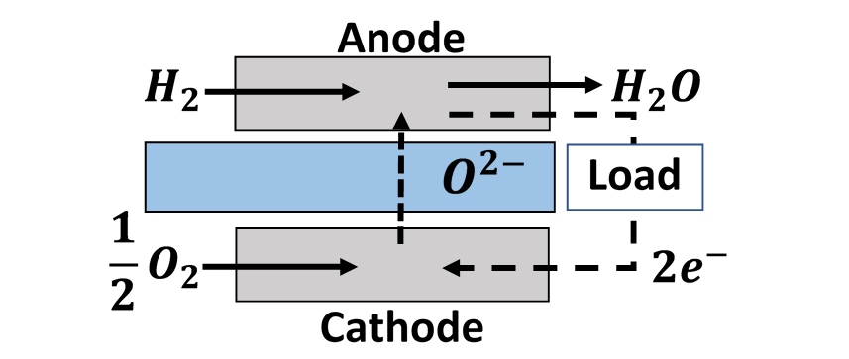
Reversible Solid Oxide Fuel Cells
Background
$${\frac{1}{2}O}_{2}+ H_{2}↔H_{2}O, ∆H_{H2}=−247KJ/{mol}$$
Notes:
This diagram shows the performance of a reversible solid oxide fuel cell system in fuel cell mode. Oxygen ions are transported across the electrically insulating electrolyte to create water from hydrogen. This drives electrons from the anode to the cathode, generating electrical power.
In electrolysis cell mode the reaction goes in the opposite direction, generating hydrogen from the use of electrical power.
The performance of the reSOFC in causing this reaction depends on the operating conditions within the reSOFC.

Slide 8
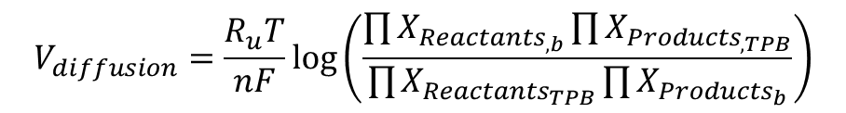
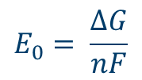



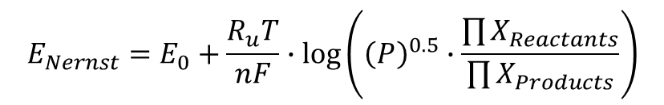

reSOFC Performance
$$V_{FC}=E_{Nernst}−V_{Loss}$$
$$J=R_{redox}∙2F$$
$$V_{EC}=E_{Nernst}+V_{Loss}$$
Open Circuit Voltage
$$E_{Nernst}=E_{0}+\frac{R_{u}T}{nF}∙\log\left({\left(P\right)}^{0.5}∙\frac{\prod{X_{Reactants}}}{\prod{X_{Products}}}\right)$$
$$E_{0}= \frac{∆G}{nF}$$
Losses
$$V_{diffusion}=\frac{R_{u}T}{nF}\log\left(\frac{\prod{X_{{Reactants}_{,b}}}\prod{X_{{Products}_{,TPB}}}}{\prod{X_{{Reactants}_{TPB}}}\prod{X_{{Products}_{b}}}}\right)$$
$$V_{Ohmic}= j∙Ω_{ASR}$$
Notes:
The rate of the oxidation reduction reaction is described in terms of a current density and the voltage.
The open circuit voltage or Nernst voltage, measures the reversible work done by the reSOFC. It is dependent on the temperature, pressure, and chemical composition.
When current flows across the reSOFC, electrical losses reduce the effectiveness of the system and decrease the voltage in fuel cell mode and increase the voltage in electrolysis cell mode.
The two loss terms used in this thesis include ohmic losses and diffusion losses.
Ohmic losses linearly increase with the current density.
Diffusion losses represent the change in the Nernst voltage from the difference in the chemical composition in the bulk flow and the chemical composition at the triple phase boundary.
This thesis employs two mechanisms to increase the efficiency of the reSOFC. First, it uses internal methanation and steam reforming.

Slide 9
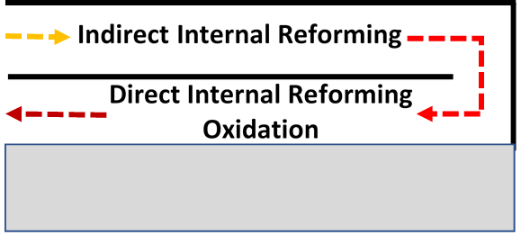

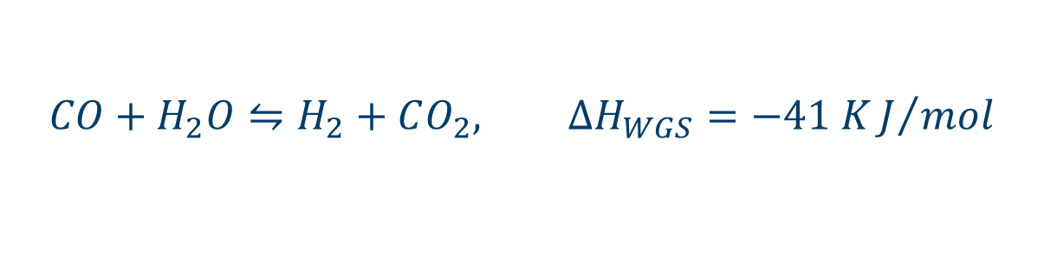
Internal Methanation and Steam Reforming
$$CH_{4}+H_{2}O⇋3H_{2}+CO, ∆H_{SR}=206 KJ/mol$$
$$CO+H_{2}O⇋H_{2}+CO_{2}, ∆H_{WGS}=−41 KJ/{mol}$$
Notes:
The steam reformation reaction endothermically generates hydrogen from methane. This is used within the reSOFC during fuel cell mode to absorb waste heat and increase the efficiency.
The methanation reaction, the reverse reaction, generates methane from hydrogen. This is used within the reSOFC during electrolysis mode to generate heat and ensure exothermic operation of the reSOFC.
Within the reSOFC, the reformation reactions occur along an indirect internal reformation plate and along the length of the reSOFC.
While these reactions are beneficial to the operation of the system, the chemical composition within the reSOFC needs to be carefully managed to avoid carbon deposition based degradation.

Slide 10
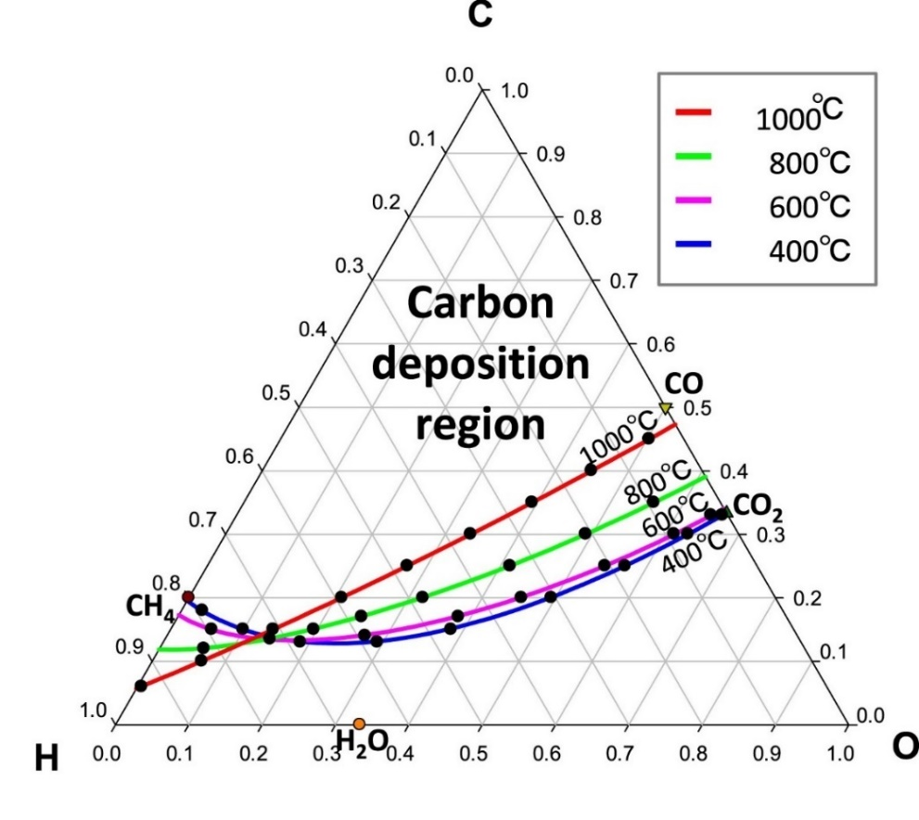
Carbon Deposition Region
Selected Composition
CO2: 0.7%
CO: 0.5%
CH4: 38%
H2: 29%
H2O: 32%
C | H | O
11% | 79% | 10%
Notes:
The figure on the left shows the carbon deposition boundary over a range of temperatures at a pressure of 20 bar. This axis shows the atomic fraction of hydrogen, this one is for oxygen, and this one is for carbon. To ensure that carbon deposition does not cause degradation of the reSOFC, you must operate below the line corresponding to the chosen temperature.
However, the rate of methanation and steam reformation increase if you operate closer to the carbon deposition boundary, resulting in increased performance of the system.
*Click*
In order to increase the amount of methanation and steam reforming while avoiding carbon deposition, a point close the carbon deposition boundary was selected.
*Click*
That results in the atomic fractions found in this table. Using the figure, it can be seen that this point doesn’t cross the carbon deposition boundary at either 800C or 600C.
*Click*
During electrolysis cell mode, the chemical composition changes from this POINT to this POINT on the figure.
Another way that the efficiency of the system was increased was through hydrogen coproduction in fuel cell mode.

Slide 11
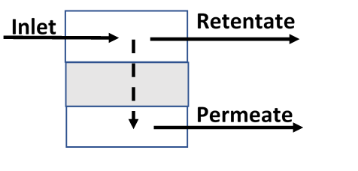
Hydrogen Transport Membrane
Coproduce Hydrogen Through Fuel Recovery of Fuel Cell Mode Exhaust Stream
Equalize Partial Pressure Of Hydrogen Across Membrane
Notes:
In fuel cell mode, only a portion of the fuel is used by the reSOFC to generate electrical power. The a portion of the hydrogen in the exhaust stream in fuel cell mode can be recovered through the use of a hydrogen transport membrane.
Over the length of the membrane, the partial pressure of hydrogen is equalized on both sides. By having a pressure difference between the retentate and permeate side of the membrane, hydrogen travels across the membrane and is recovered by the system. The recovered hydrogen is then stored at 700 bar and assumed to be sold.
A diagram of the system, including the Hydrogen transport membrane, can be seen in the next slide.

Slide 12
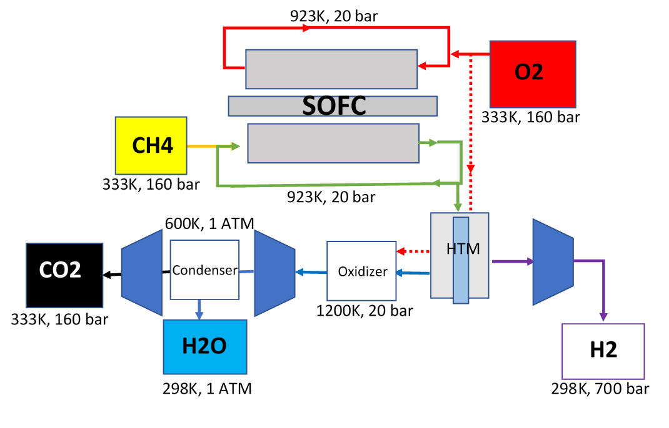
reSOFC System: Fuel Cell Mode
Notes:
In fuel cell mode, the system converts methane and Oxygen to electrical power.
*describe system*

Slide 13
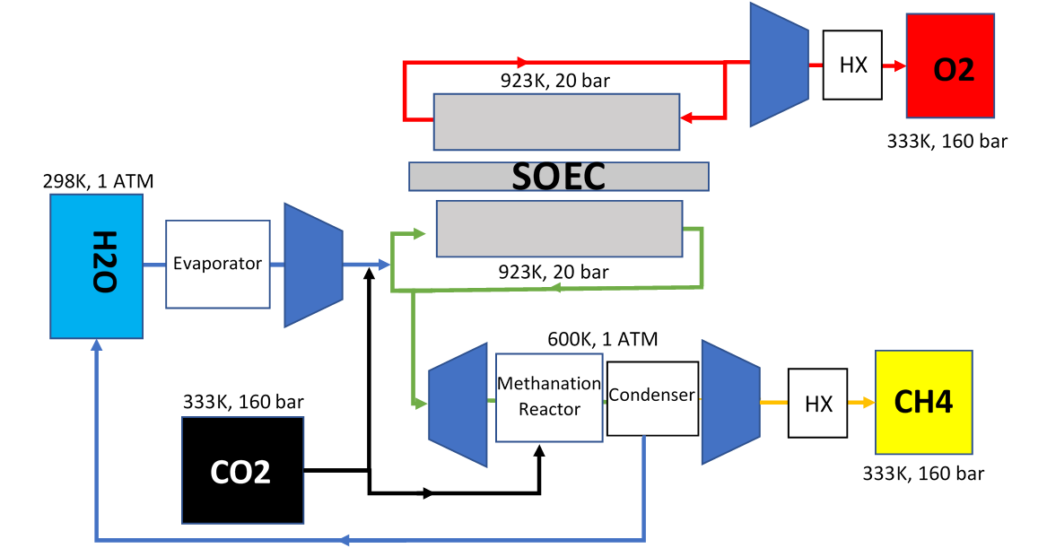
reSOFC System: Electrolysis Cell Mode
Notes:
In electrolysis cell mode, electrical power is stored in the form of CH4.
*describe system*

Slide 14
Outline
Literature Review
Background
System Model
Energy Storage Application
Conclusions
Notes:
Now that I’ve gone over the necessary background information, I will describe the system model that I created for this thesis.

Slide 15
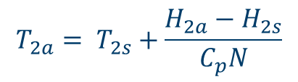
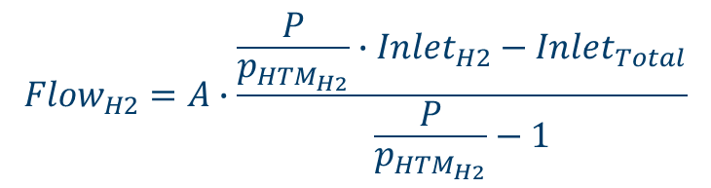

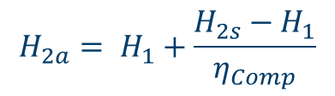
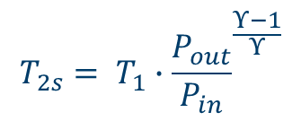
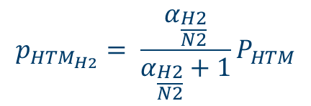
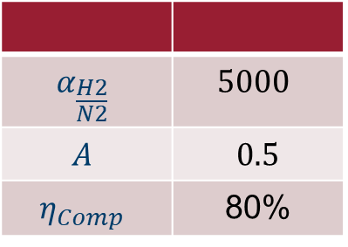
Component Models
System Model
System model created from steady state component level models
Compressor
$$α_{\frac{H2}{N2}}$$ | $$5000$$
$$A$$ | $$0.5$$
$$η_{Comp}$$ | 80%
HTM
$$T_{2s}= T_{1}∙{\frac{P_{out}}{P_{in}}}^{\frac{Υ−1}{Υ}}$$
$$p_{{HTM}_{H2}}= \frac{α_{\frac{H2}{N2}}}{α_{\frac{H2}{N2}}+1}P_{HTM}$$
$$H_{2a}= H_{1}+\frac{H_{2s}−H_{1}}{η_{Comp}}$$
$${Flow}_{H2}=A∙\frac{\frac{P}{p_{{HTM}_{H2}}}∙{Inlet}_{H2}−{Inlet}_{Total}}{\frac{P}{p_{{HTM}_{H2}}}−1}$$
$$W_{Comp}= H_{2a}−H_{1}$$
$$T_{2a}= T_{2s}+\frac{H_{2a}−H_{2s}}{C_{p}N}$$
Notes:
A steady state model for the system was created by interlinking steady-state component models for each component in the system. Example system models for the compressor and HTM are given here.
In the compressor model, the performance of the compressor is given in terms of the isentropic efficiency. Here it is assumed that the efficiency of the compressor is always 80%.
In the HTM model, the flow rate of hydrogen from the retentate side to the permeate side of the membrane is found in terms of the ideal flow rate. Here it is assumed that only 50% of the ideal value flows across the membrane.

Slide 16
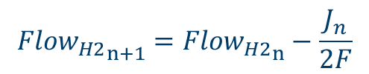
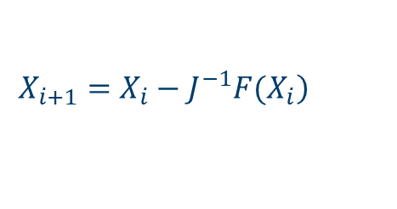
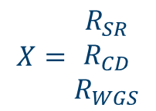
reSOFC Model
Inlet
Outlet
Reformer Plate
reSOFC
$${{Flow}_{H2}}_{n+1}={{Flow}_{H2}}_{n}−\frac{J_{n}}{2F}$$
Spatially Discretized Nodal Model
Symmetry
Chemical Composition
Voltage
$$X=\begin{matrix}R_{SR} \\ R_{CD} \\ R_{WGS}\end{matrix}$$
$$\left.X_{i+1}=X_{i}−J^{−1}F(X_{i}\right)$$
Notes:
The reSOFC component is modeled through a spatially discretized nodal model. The first node is used to model the bulk flow along the entire length of the reformer plate. Every other node is used to model an control volume along the length of the reSOFC.
Since it is assumed that cell properties only change in the direction of flow, the problem can be simplified into a 1D problem, creating a line of nodes as seen in the figure.
At each node, the cell properties, including voltage, are calculated.
The chemical composition at each node is assumed to reach chemical equilibrium and is calculated iteratively using Newton’s Method. The oxidation reduction reaction causes the chemical composition to change along the length of the reSOFC.
The current distribution to create an isopotential surface is then found iteratively.
Other cell properties, such as the thermal balance and efficiency are calculated for the entire cell.

Slide 17
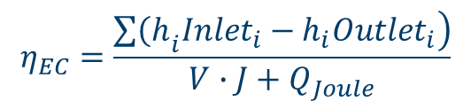
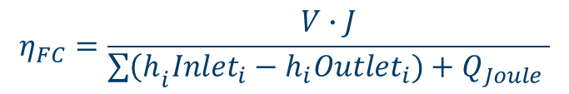

Nodal reSOFC Model (cont)
Thermal Balance
$$0=Q_{Equilibrium}+Q_{reSOFC}+Q_{HX}+Q_{Joule}$$
$$Q_{Equilibrium}=∆H_{SR}∙R_{SR}+{∆H}_{CD}∙R_{CD}+{∆H}_{WGS}∙R_{WGS}$$
$Q_{reSOFC}=(\frac{∆H_{H2}}{2F}+V)∙J$
Cell Efficiency
$$η_{FC}=\frac{V∙J}{\sum{{\left(h\right.}_{i}{Inlet}_{i}−h_{i}{Outlet}_{i})+Q_{Joule}} }$$
$$η_{EC}=\frac{\sum{\left.{\left(h\right.}_{i}{Inlet}_{i}−h_{i}{Outlet}_{i}\right)}}{V∙J+Q_{Joule}}$$
Notes:
Since the system model is a steady state model, the net heat generated by the system must be zero. This term describes the impact of the chemical reactions within the reSOFC, this term describes the heat generated by the reSOFC, this term describes heat used by the reSOFC to preheat inlets, and this term describes heat generated using Joule Heating.
The heat generated by the reSOFC can be described in terms of the voltage and current density.
The efficiency definition for the reSOFC incorporates both he electrical power used by the oxidation reduction reaction and any joule heating that is necessary to maintain thermoneutral operation. The efficiency is calculated in terms of the net enthalpy change due to the effects of the methanation and steam reformation reactions.

Slide 18
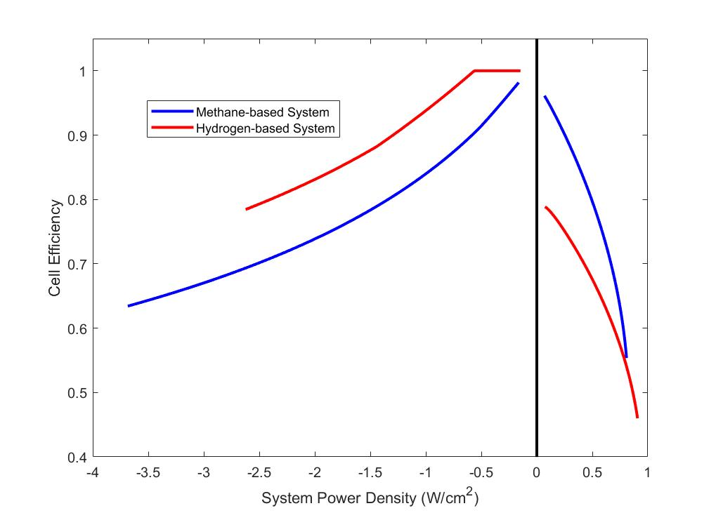
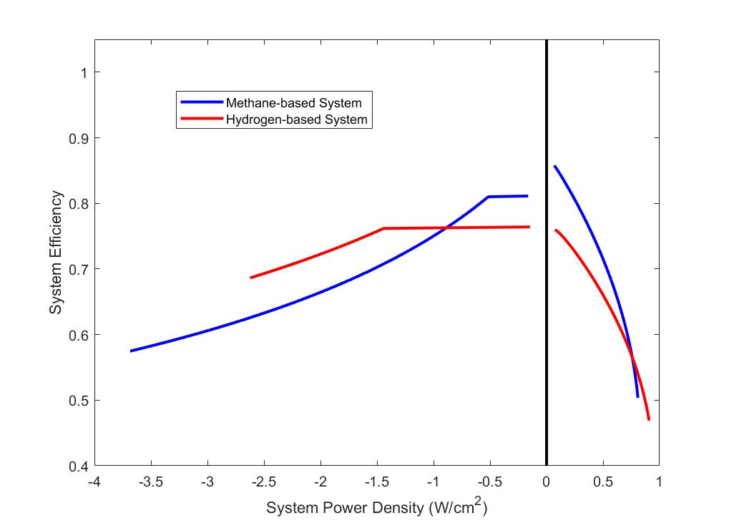
Comparison to a Hydrogen-based System
$${CH}_{4}+ 2O_{2}↔{2H}_{2}O+{CO}_{2}, ∆H_{CH4}=−802KJ/mol$$
$$4H_{2}+ 2O_{2}↔{4H}_{2}O, 4∙∆H_{H2}=−988KJ/mol$$
Notes:
On the left, the performance of a reSOFC is compared when using methane and hydrogen using a constant reactant utilization rate. The hydrogen-based reSOFC displays higher efficiencies in electrolysis cell mode, but the methane-based reSOFC displays higher efficiencies in fuel cell mode.
In fuel cell mode, waste heat is absorbed by the steam reformation reaction, increasing the electrical efficiency. In electrolysis cell mode, heat is generated by the methanation reaction, reducing the efficiency.
The performance of the reSOFC system, including the impact of electrical losses to the balance of plant, using a constant reactant utilization rate, is shown on the right. Here the efficiency of the system is described in terms of a ratio of the power input and power output. The methane-based system displays higher efficiencies in both fuel cell mode and electrolysis cell mode compared to the hydrogen-based system at low power densities.
In fuel cell mode, the flow rate of reactants must be higher than in the hydrogen-based system to generate the same power output due to the difference in the net change in enthalpy. This results in higher losses to the balance of plant, reducing the benefits of using methane in fuel cell mode, and a lower maximum power density.
In electrolysis cell mode, the net chemical reaction results in less water being used. Using the chemical composition described earlier, the methane-based system is able to achieve a 42% higher current density than the hydrogen-based system with the same reactant flow rate and steam utilization. This results in reduced losses to the balance of plant, and a higher efficiency in the methane-based system at low power densities.
The benefits of the methanation reaction to the thermal management of the system can also be described in terms of the voltage.

Slide 19
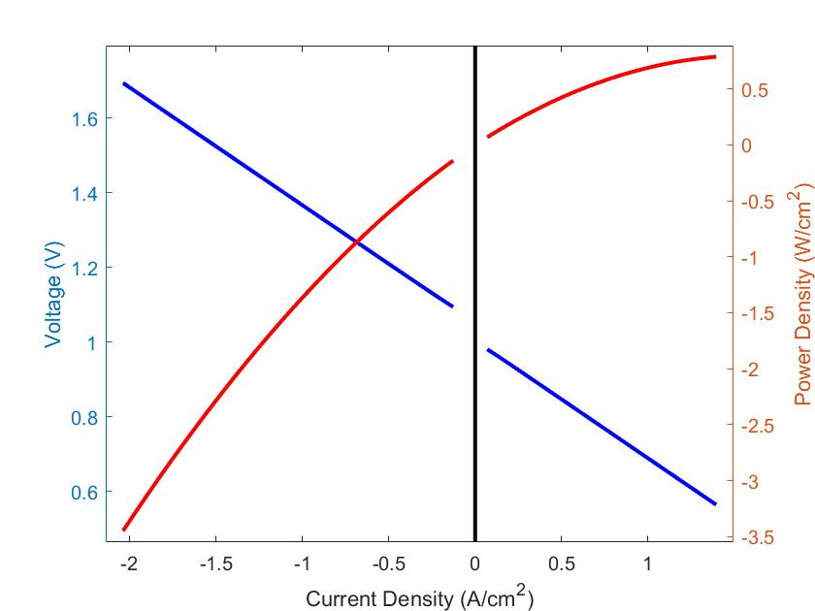
Methane-based reSOFC Voltage
Notes:
This figure shows the voltage in fuel cell mode and electrolysis cell mode for a methane-based reSOFC, generated using the same parameters used to create the previously described efficiency curve.
The difference in the voltage in electrolysis cell mode and fuel cell mode can be attributed to differences in the chemical composition. Since electrolysis cell mode operates at a higher partial pressure of hydrogen than fuel cell mode in order to drive the methanation reaction, the voltage is higher.
One important thing to note on this figure is that electrolysis cell mode results in exothermic operation, as shown by the sub-100% efficiencies in the previous figure. The thermoneutral voltage of a hydrogen-based electrolysis cell is ~1.3 volts at 650C. Here, thermoneutral operation is obtained at voltages as low as 1.1 Volts due to the heat generated by the methanation reaction.
This reduction in the thermoneutral voltage results in the potential to operate at lower current densities, potentially reducing the rate of degradation within the reSOFC.

Slide 20
Outline
Literature Review
Background
System Model
Energy Storage Application
Conclusions
Notes:
Now that the system model has been described, we can apply it to the problem of increasing the use of renewable energy.

Slide 21
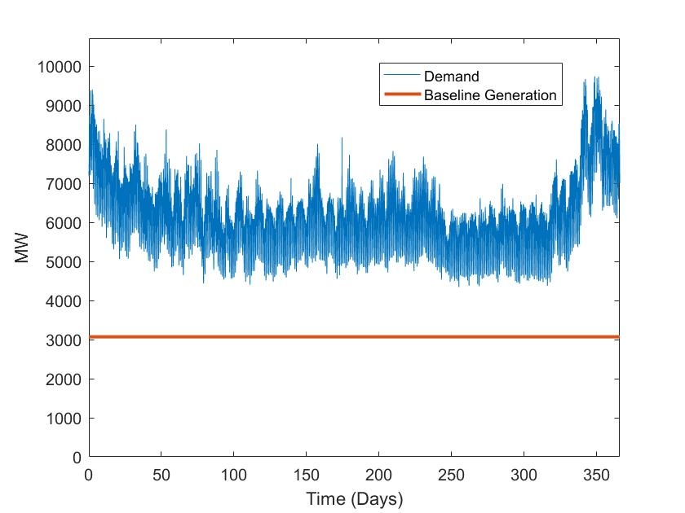
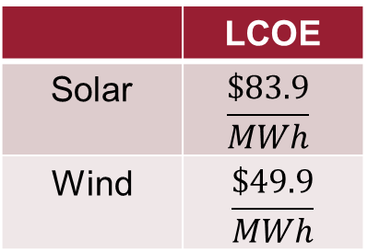
Demand Profile
Energy Storage Application
Curtailment
Battery Energy Storage
reSOFC-based Energy Storage
 | LCOE
Solar | $$\frac{\$83.9}{MWh}$$
Wind | $$\frac{\$49.9}{MWh}$$
$${P_{Demand}}_{i}={P_{BaseLoad}}_{i}+{P_{Conventional}}_{i}+{P_{Renewables}}_{i}+{P_{Storage}}_{i}$$
Notes:
To better evaluate the performance of a reSOFC-based energy storage system, three strategies are compared in increasing the amount of demand that is met by renewable energy. These strategies include reSOFC based energy storage, battery energy storage, and curtailment.
In the curtailment strategy, renewable energy that can’t be used to meet demand is curtailed.
In the battery energy storage strategy, excess renewable energy is stored for later use in a lithium-ion battery based energy storage system.
Performance of each system is evaluated using a yearly demand profile, broken up into 5 minute intervals, that is consistent with the Pacific Northwest. Demand data is taken from the Bonneville Power Administration. Here it assumed that 50% of the yearly energy demand is met by baseline generation, shown in this figure HERE. This limits the amount of renewable power that can be used.
The performance of each system is then compared over a range of installed capacities of wind and solar power. Wind and solar power profiles are created from real-world data and scaled up to the desired size, using costs that are representative of those found in Washington state.
Additional complications arise in analyzing the battery energy storage and reSOFC-based energy storage strategies.

Slide 22

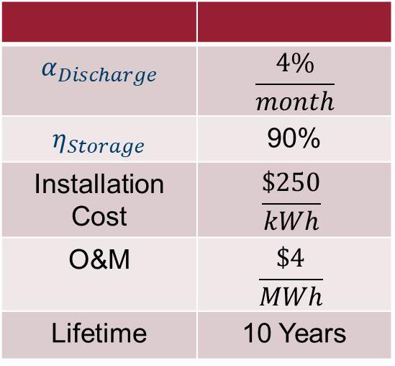

Battery Energy Storage
$$α_{Discharge}$$ | $$\frac{4\%}{month}$$
$$η_{Storage}$$ | 90%
Installation Cost | $$\frac{\$250}{kWh}$$
O&M | $$\frac{\$4}{MWh}$$
Lifetime | 10 Years
Self-Discharge
$${P_{Discharge}}_{i}=\frac{{E_{Storage}}_{i}∙α_{Discharge}}{∆t}$$
$${E_{Storage}}_{i}={E_{Storage}}_{i−1}+({η_{Storage}∙P_{Storage}}_{i}−{P_{Discharge}}_{i})∙∆t$$
$${E_{Storage}}_{i}={E_{Storage}}_{i−1}−(\frac{{P_{Storage}}_{i}}{η_{Storage}}+{P_{Discharge}}_{i})∙∆t$$
Notes:
In the battery energy storage strategy, self-discharge within the battery causes the energy stored within the battery to slowly decrease over time. The effect of self discharge can be seen in *THESE* equations. While the effect of self-discharge is relatively low at 4%/month at shorter time scales, it makes it more difficult for battery energy storage to address seasonal variation in the availability of renewable power and in demand.
Within this model, the efficiency of charging and discharging is fixed at 90%, resulting in a roundtrip efficiency of 81% when ignoring the effects of self-discharge. The maximum rate of charge and discharge is limited such that the battery is able to fully charge/discharge in 1 hour.

Slide 23
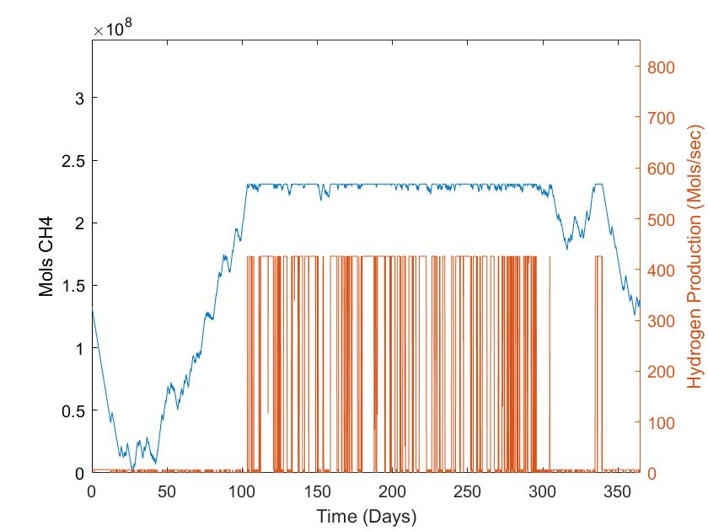
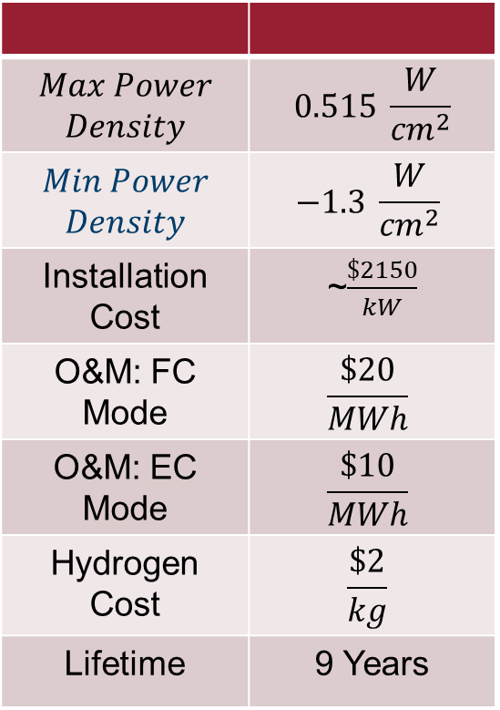

reSOFC-based Energy Storage
$$Max Power$$ $$Density$$ | $$0.515 \frac{W}{{cm}^{2}}$$
$$Min Power$$ $$Density$$ | $$−1.3 \frac{W}{{cm}^{2}}$$
Installation Cost | ~$\frac{\$2150}{kW}$
O&M: FC Mode | $$\frac{\$20}{MWh}$$
O&M: EC Mode | $$\frac{\$10}{MWh}$$
Hydrogen Cost | $$\frac{\$2}{kg}$$
Lifetime | 9 Years
$$S_{Limit}={S_{End}}_{1}+{S_{Max}}_{1}−{S_{End}}_{2}$$
Notes:
Performance of the reSOFC-based energy storage system has two main differentiating characteristics.
1st, the size of the underground storage caverns and the size of the reSOFC system are independent. This means energy storage capacity and rate of storage are independent. In this model, underground storage caverns are sized such that the maximum amount of demand is met without storing excess methane.
2nd, the system coproduces hydrogen. In fuel cell mode, the HTM generates a relatively small but consistent stream of hydrogen. Additionally, when the methane storage cavern is full, excess renewable power is used to generate hydrogen. This can be seen in *THIS* figure.

Slide 24
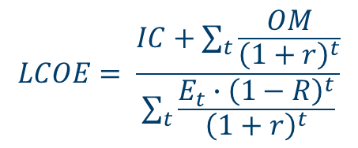


Comparison Methodology
$$LCOE= \frac{IC+\sum_{t}{\frac{OM}{{\left(1+r\right)}^{t}}}}{\sum_{t}{\frac{E_{t}∙{\left(1−R\right)}^{t}}{{\left(1+r\right)}^{t}}}}$$
$$β_{Solar}=\frac{E_{Solar}}{E_{Solar}+E_{Wind}}$$
$${Pen}_{Renewable}=\frac{\sum{{P_{Renewable}}_{i}+{P_{Storage}}_{i}}}{\sum{{P_{Demand}}_{i}}}$$
Notes:
To compare these strategies, three main metrics are used: the levelized cost of electricity, the solar capacity factor, and the annual renewable energy penetration.
The levelized cost of electricity, or LCOE, measures the average cost of electricity over the lifetime of a system.
The solar capacity factor measures the percentage of renewable energy that comes from solar power.
The annual renewable energy penetration measures the proportion of demand that is met by renewable power and energy storage.
This thesis uses these terms in two ways:
First, the change in the LCOE over a range of annual renewable energy penetrations is found. This shows how the cost of electricity increases as more renewable energy is used.
Second, the change in the solar capacity fraction that results in the best performance is found over a range of annual renewable energy penetrations. This shows how the optimal configuration of the system changes as more renewable energy is used.
r = discount rate = 5.6%, R = degradation rate

Slide 25
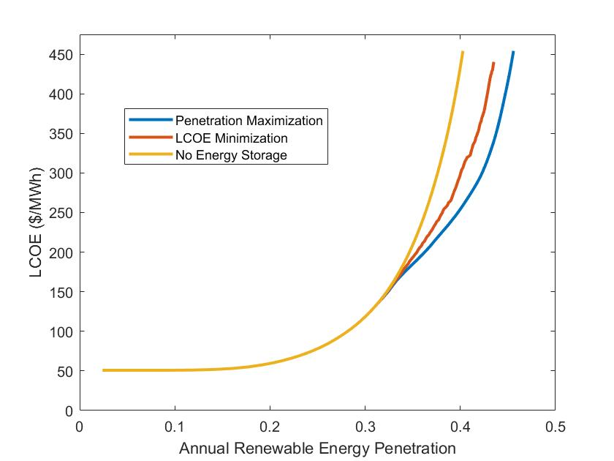
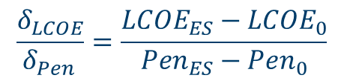
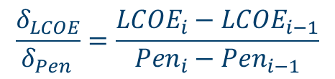
Optimization Methodology
Energy Storage Sizing
Solar Capacity Factor
Grid-based Search
Installed Capacity
Solar Capacity Factor
$$\frac{δ_{LCOE}}{δ_{Pen }}=\frac{{LCOE}_{ES}−{LCOE}_{0}}{{Pen}_{ES}−{Pen}_{0}}$$
$$\frac{δ_{LCOE}}{δ_{Pen }}=\frac{{LCOE}_{i}−{LCOE}_{i−1}}{{Pen}_{i}−{Pen}_{i−1}}$$
Notes:
To find the optimal configuration under each strategy, a derivative based search method and a grid-based search method are used.
The derivative based search method is used to maximize the effectiveness of energy storage for a given mixture of wind and solar power. Effectively, this maximizes the penetration such that the LCOE without storage is the same as the LCOE with storage. This results in optimal sizing of energy storage for a given amount of wind and solar power. By using this method over a range of installed capacities of wind and solar power, the cost of the system with optimal sizing is found for every system configuration in *THIS* grid.
The grid-based search method is then used to find the optimal system configuration over a range of annual renewable energy penetrations. By minimizing the value of *THIS* derivative when selecting configurations, the optimal configuration is found over a range of annual renewable energy penetrations.

Slide 26
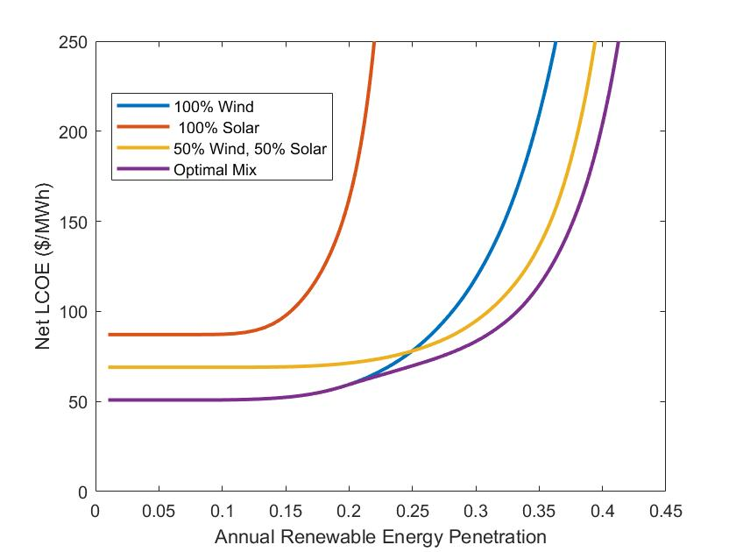
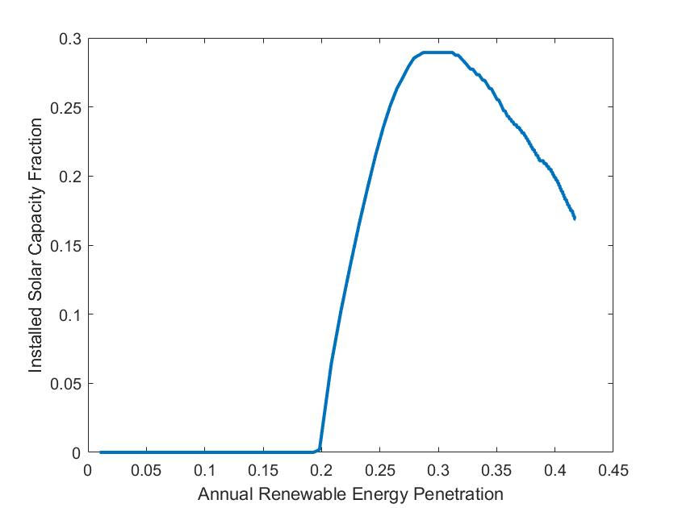
Curtailment

Slide 27
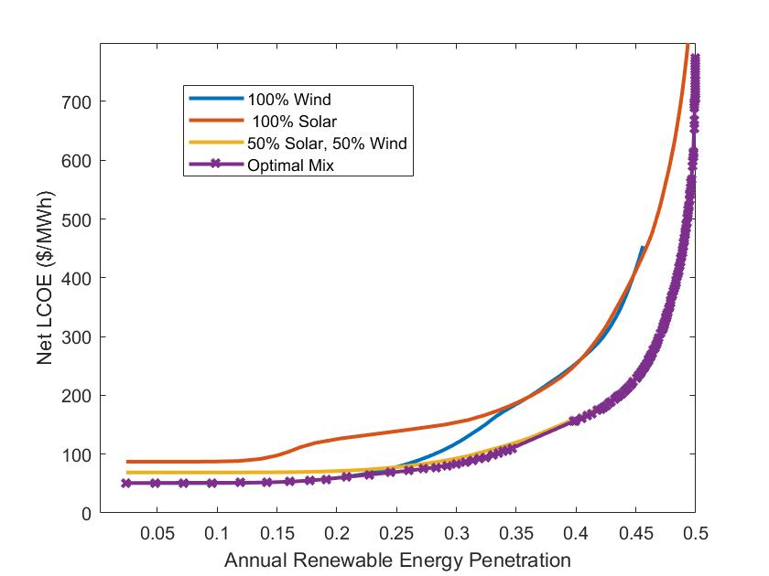
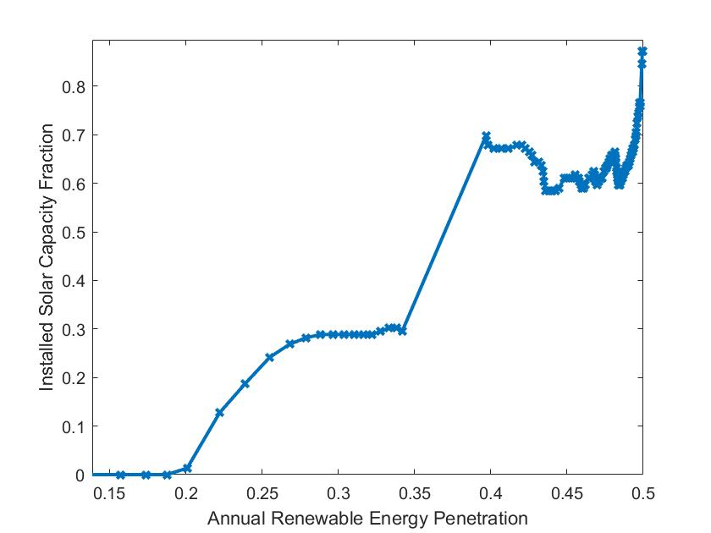
Battery Energy Storage

Slide 28
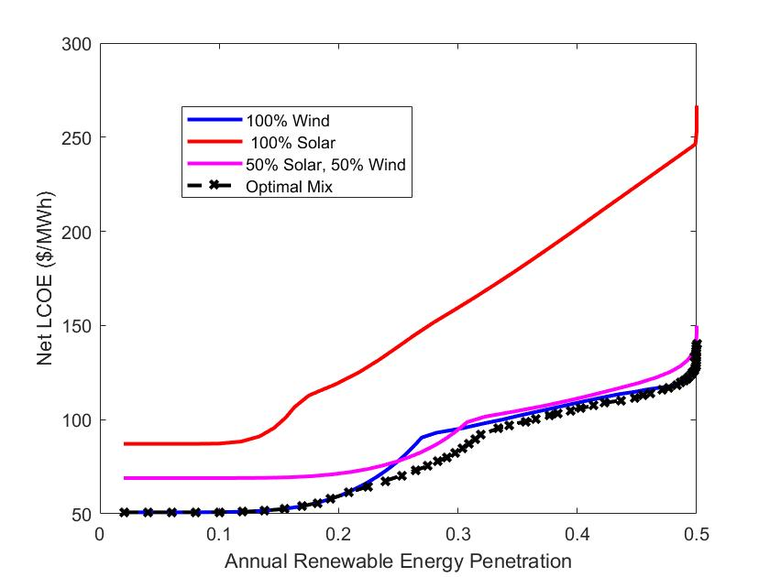
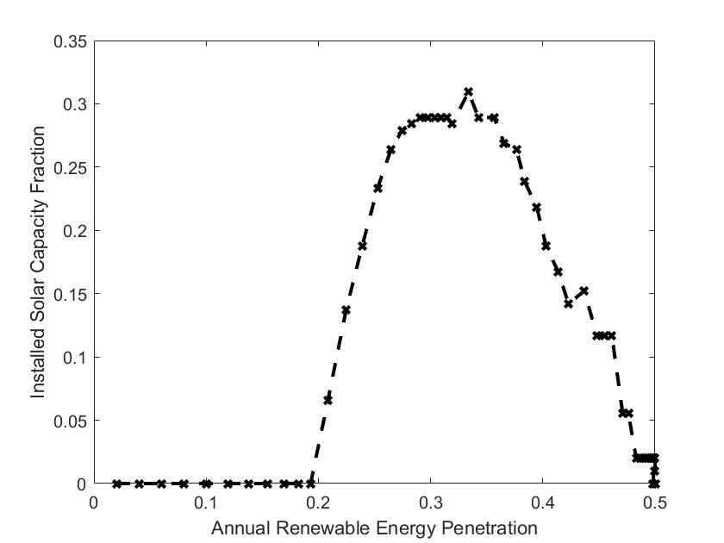
reSOFC-based Energy Storage

Slide 29
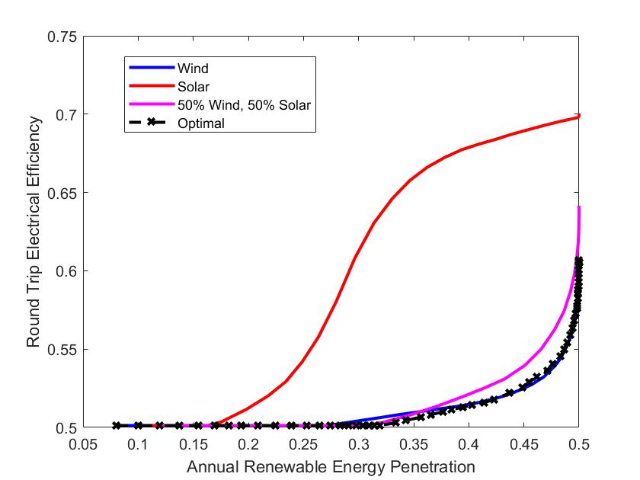
Optimal reSOFC Energy Storage System Efficiency

Slide 30
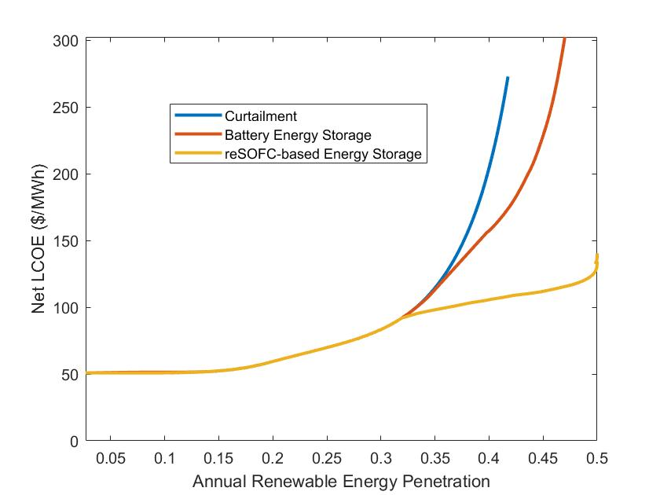
Optimal LCOE Comparison

Slide 31
Outline
Literature Review
Background
System Model
Energy Storage Application
Conclusions

Slide 32
Conclusions
Internal methanation and steam reforming improve system performance.
Higher System Efficiency
Lower Thermoneutral Voltage
Cost competitive with other energy storage technologies.
Optimal sizing does not result in a sudden change in strategy.

Slide 33
References

Slide 34
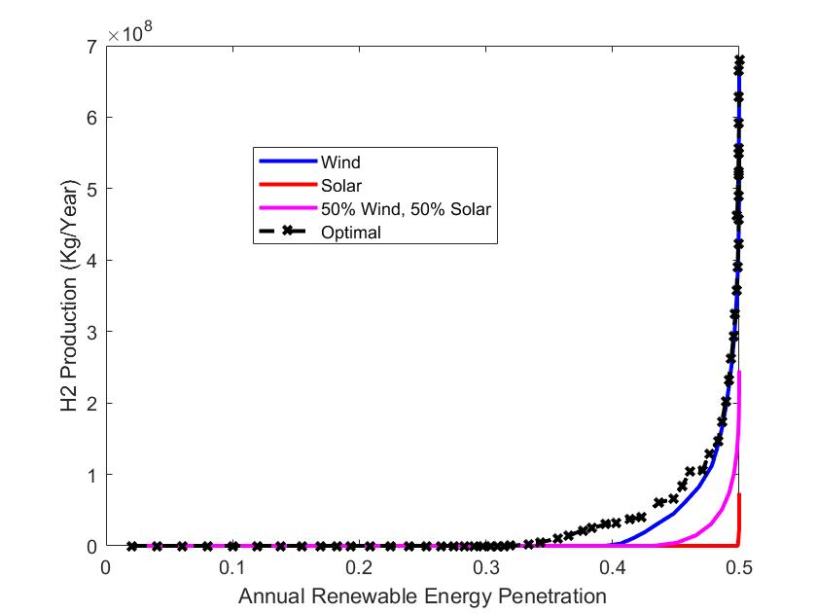
Hydrogen Production by reSOFC System

Slide 35
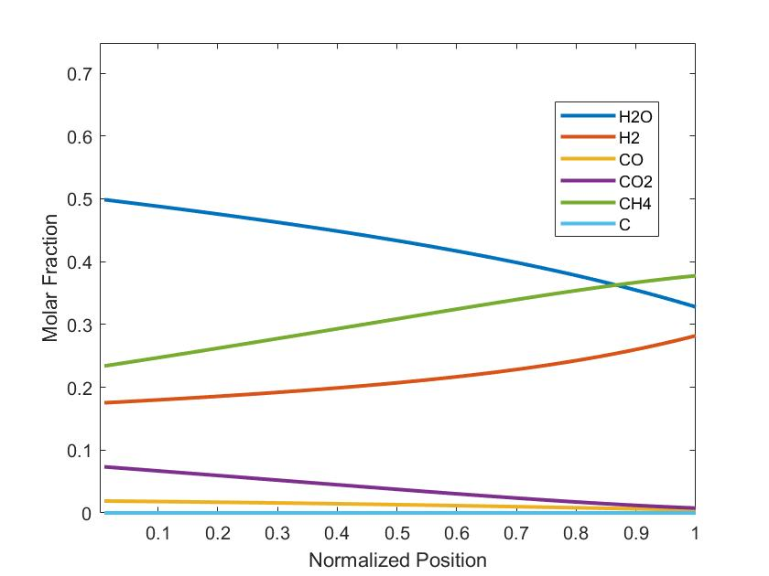
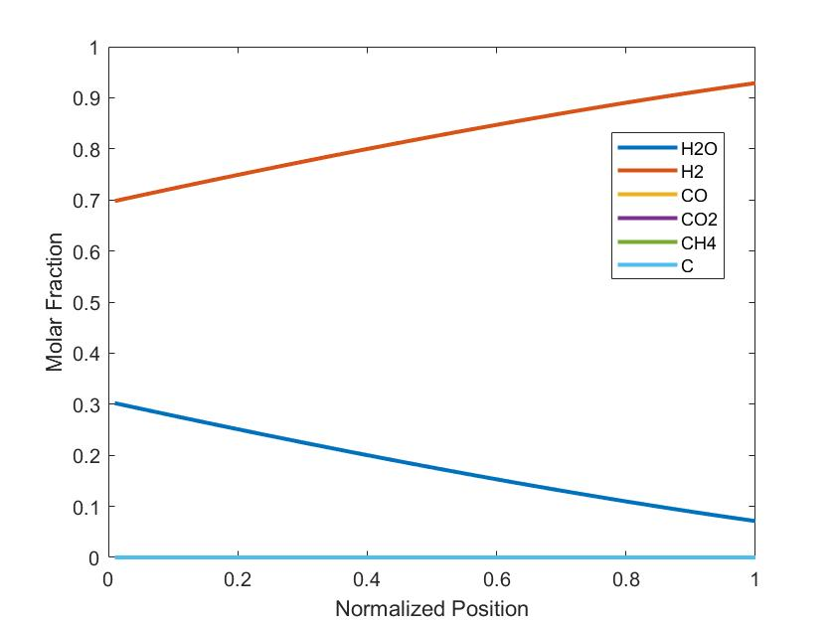
Chemical Composition Electrolysis Cell Mode
Methane-based reSOFC
Hydrogen-based reSOFC

Slide 36
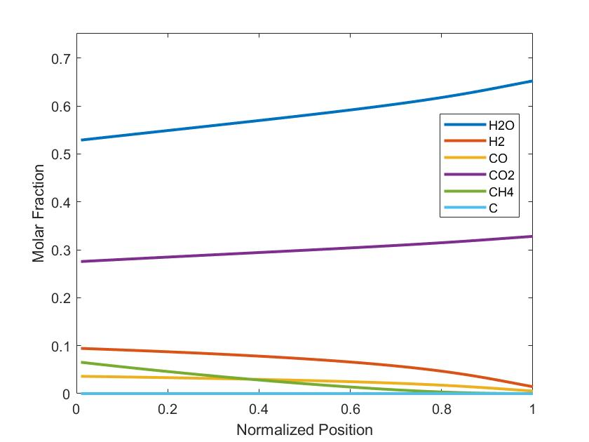
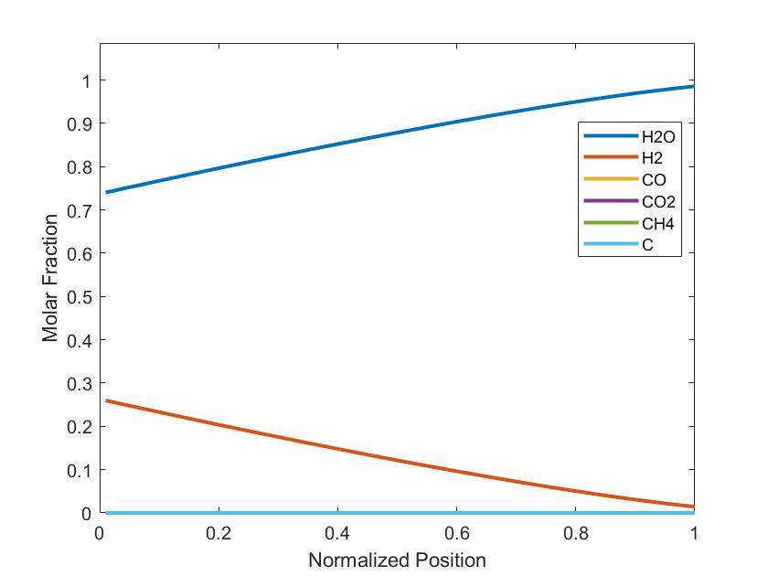
Chemical Composition Fuel Cell Mode
Methane-based reSOFC
Hydrogen-based reSOFC

Slide 37
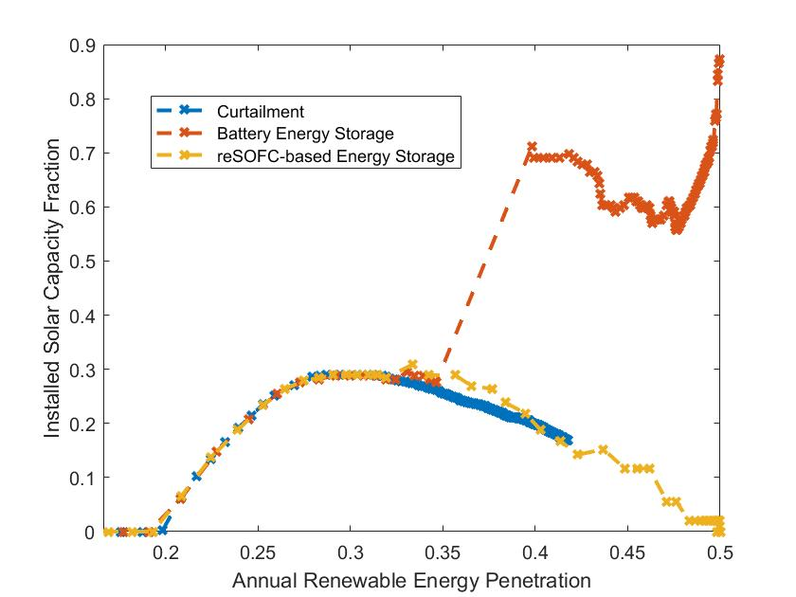
Optimal Solar Capacity Fraction Comparison

Slide 38

Effect of the HTM

Slide 39









Nodal reSOFC Model (cont)
Chemical Composition Found Using Newton’s Method
$$X=\begin{matrix}R_{SR} \\ R_{CD} \\ R_{WGS}\end{matrix}$$
$$F(x)=\begin{matrix}K_{Steam}p_{{CH}_{4}}p_{H_{2}O}−p_{CO}{p_{H_{2}}}^{3} \\ K_{CD}p_{{CH}_{4}}−p_{C}{p_{H_{2}}}^{2} \\ K_{WGS}p_{CO}p_{H_{2}O}−p_{H_{2}}p_{{CO}_{2}}\end{matrix}$$
$$J=\begin{matrix}\frac{∂F}{∂X_{1}} & \frac{∂F}{∂X_{2}} & \frac{∂F}{∂X_{3}}\end{matrix}$$
$$\left.X_{i+1}=X_{i}−J^{−1}F(X_{i}\right)$$
Current Distribution Found Iteratively
$$U_{Steam}=\frac{R_{redox}}{{Inlet}_{H_{2}O}}$$
$$J=R_{redox}∙2F$$
$$U_{Fuel}=\frac{R_{redox}}{{4∙Inlet}_{{CH}_{4}}+{Inlet}_{CO}+{Inlet}_{H_{2}}}$$
$${{Flow}_{H2O}}_{n+1}={{Flow}_{H2O}}_{n}+\frac{J_{n}}{2F}$$
$${{Flow}_{H2}}_{n+1}={{Flow}_{H2}}_{n}−\frac{J_{n}}{2F}$$

